Slide 1
The New York Experience
CIS 550 Final Project
Group 20: Aakash, Karan, Kush, Yathu
Notes:
Kush

Slide 2
Basic Problem & Goals
Which Airbnbs are in a locality with an active nightlife?
Filter by longitude and latitude
Which neighbourhood is predominantly “touristy”?
Aggregate by number of listings in each locality
Who are the top hosts in each neighbourhood?
Filter by average rating of all the BnBs owned by a host
Are the amenities in Airbnbs verified by users?
Search by amenities and subsequently filter by comments
What are the cheapest Airbnbs in a given borough?
Filter by price
Notes:
Kush

Slide 3
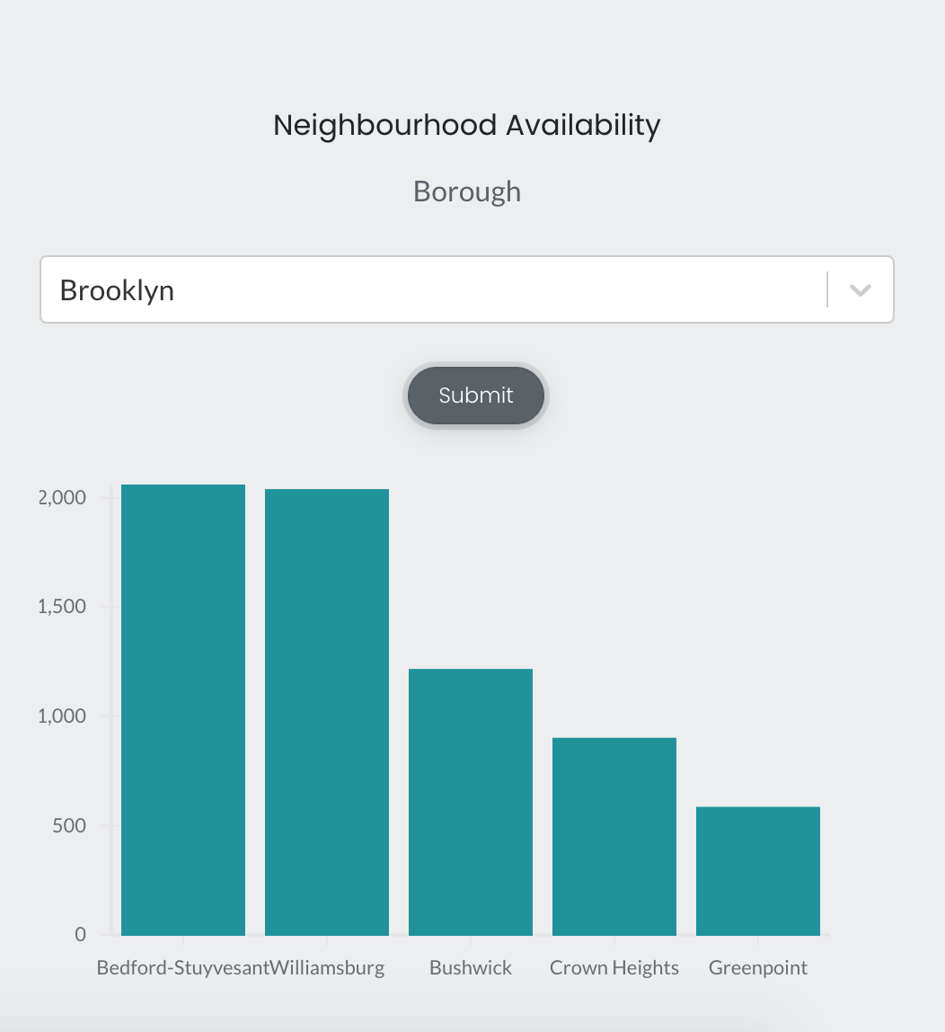
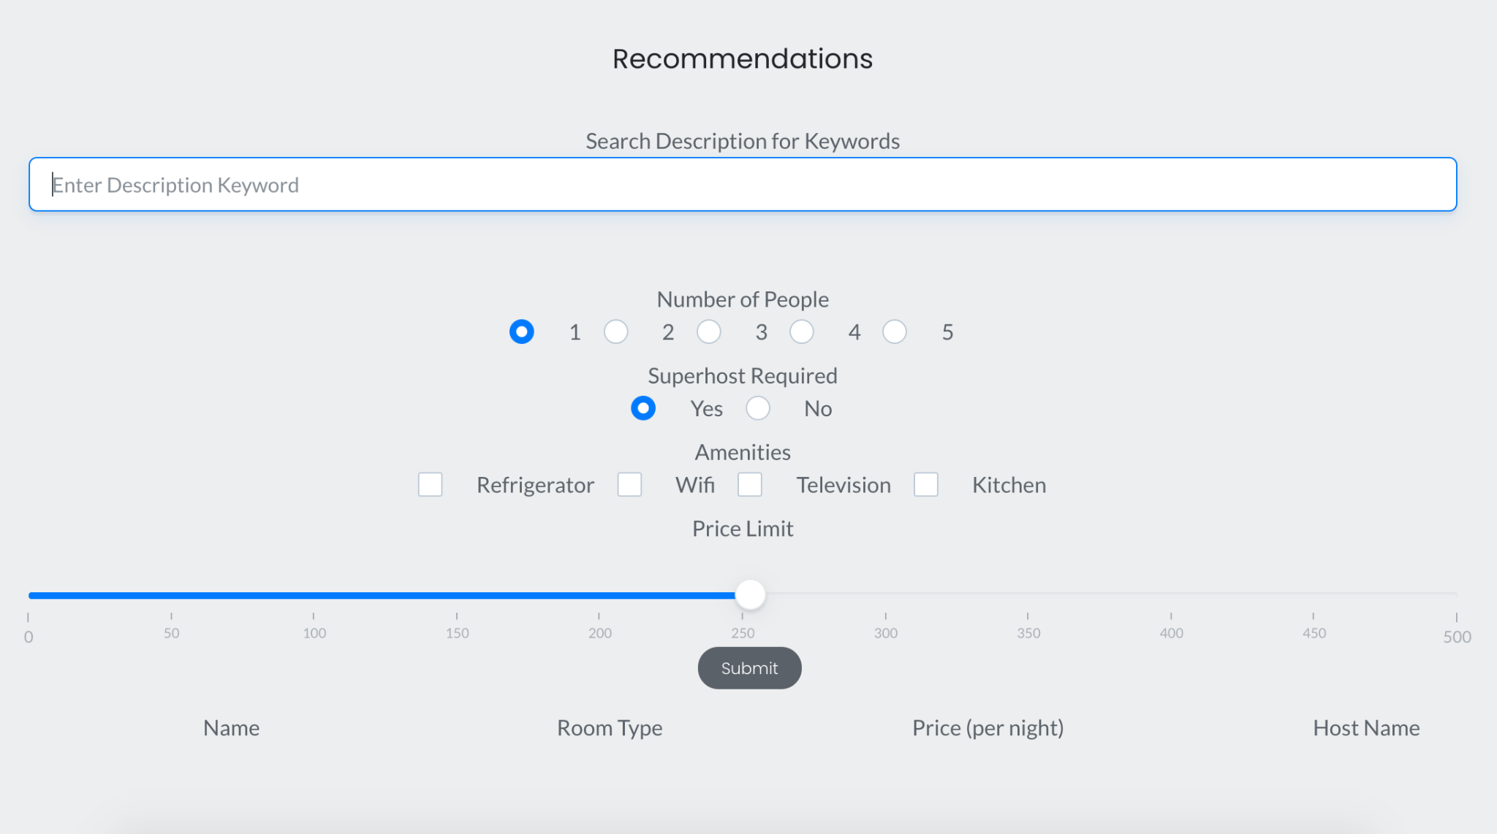
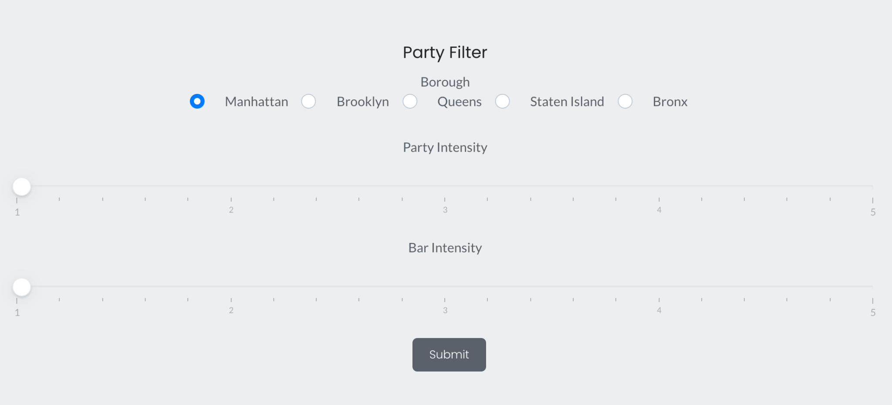
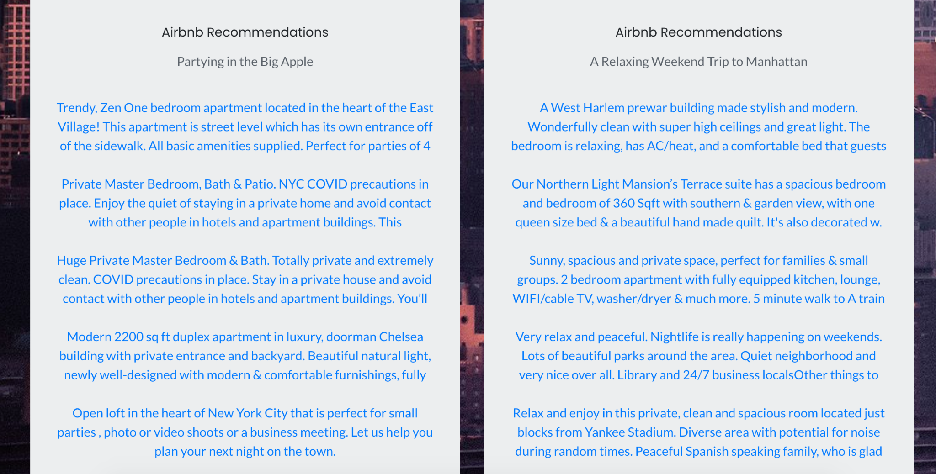
Preview
Notes:
Kush

Slide 4
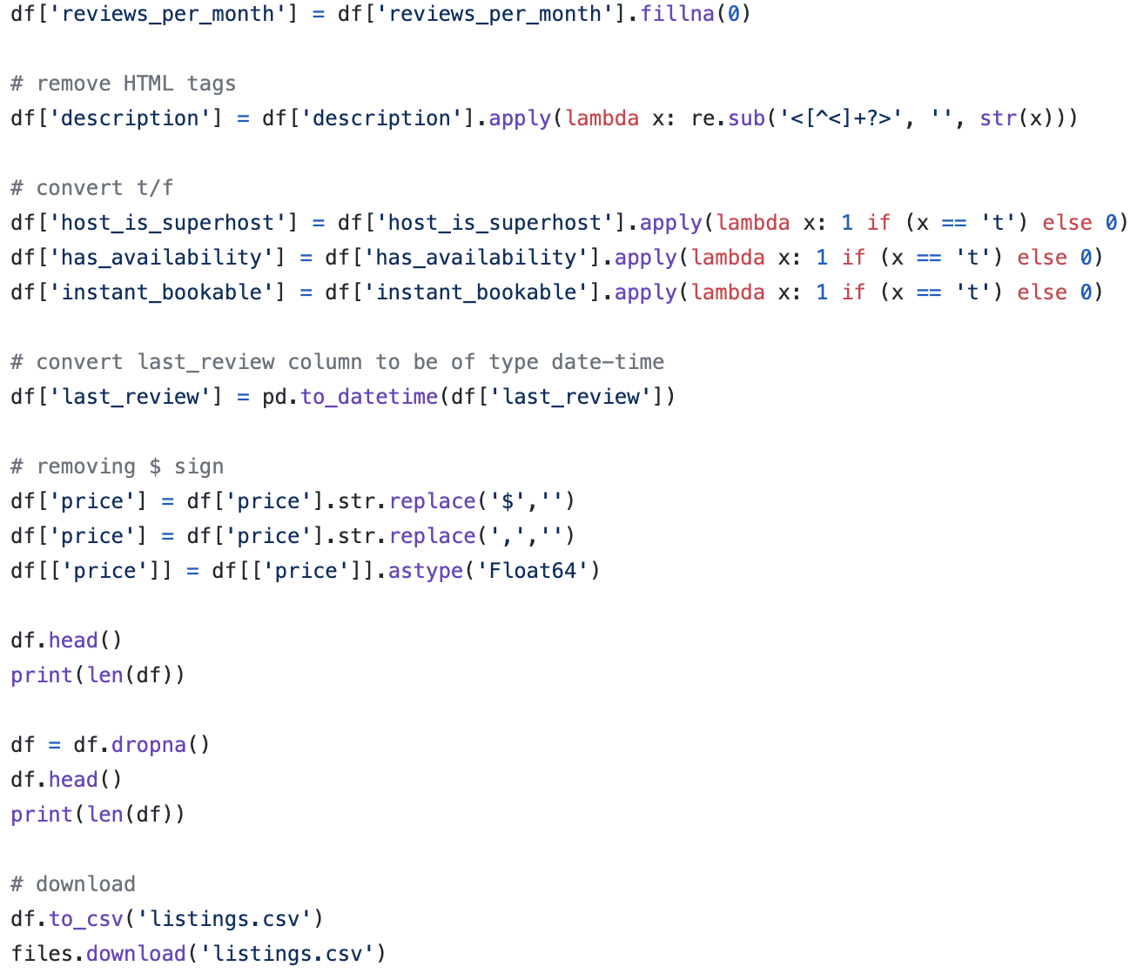
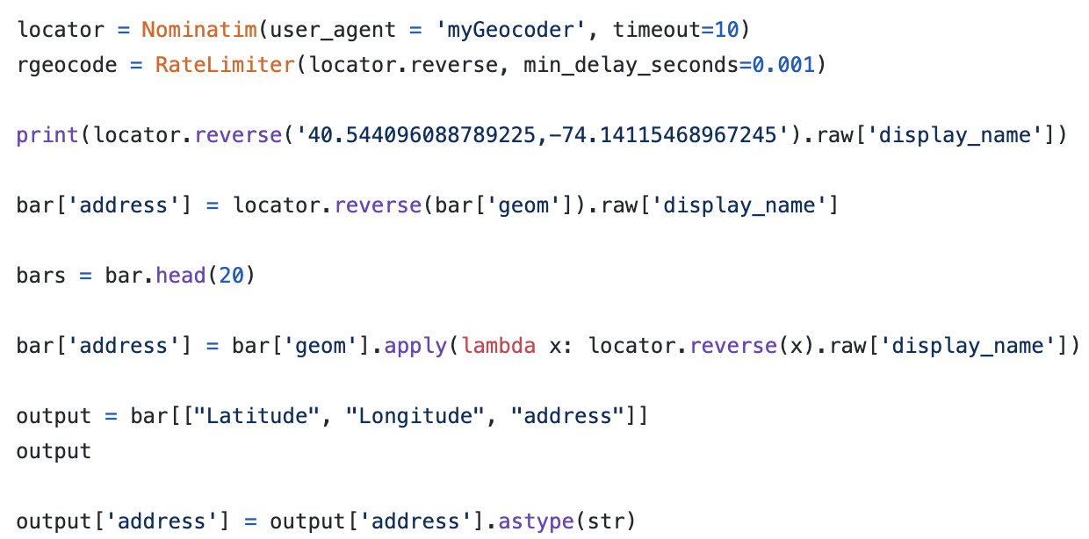
Data collection and preprocessing
The data was collected from:
Bar Locations: www.kaggle.com/somesnm/partynyc
Airbnb NYC: insideairbnb.com/get-the-data.html
Verification: www.nycgo.com/things-to-do/nightlife
Preprocessing was primarily done in python using:
Pandas
Numpy
Matplotlib
Preprocessing the data included:
Dropping columns and tables that were of no use.
Tuples with null values were discarded.
Missing numerical value were replaced with 0s.
Impossible values such as price < 0 were discarded.
Creation of new address table using geolocator API.
Notes:
Karan J

Slide 5
Datasets
Table Name | Number of features | Number of Instances
LatLong | 3 | 137,879
Bar | 5 | 2441
Parties | 6 | 225,415
Lsting | 17 | 27,186
Hosts | 5 | 3428
Reviews | 5 | 846,587
Addresses | 3 | 2441
Neighbourhood | 2 | 68
The following relations were created from the original dataset in such a manner that BCNF and 3CNF constraints were not violated.
Notes:
Aakash J

Slide 6
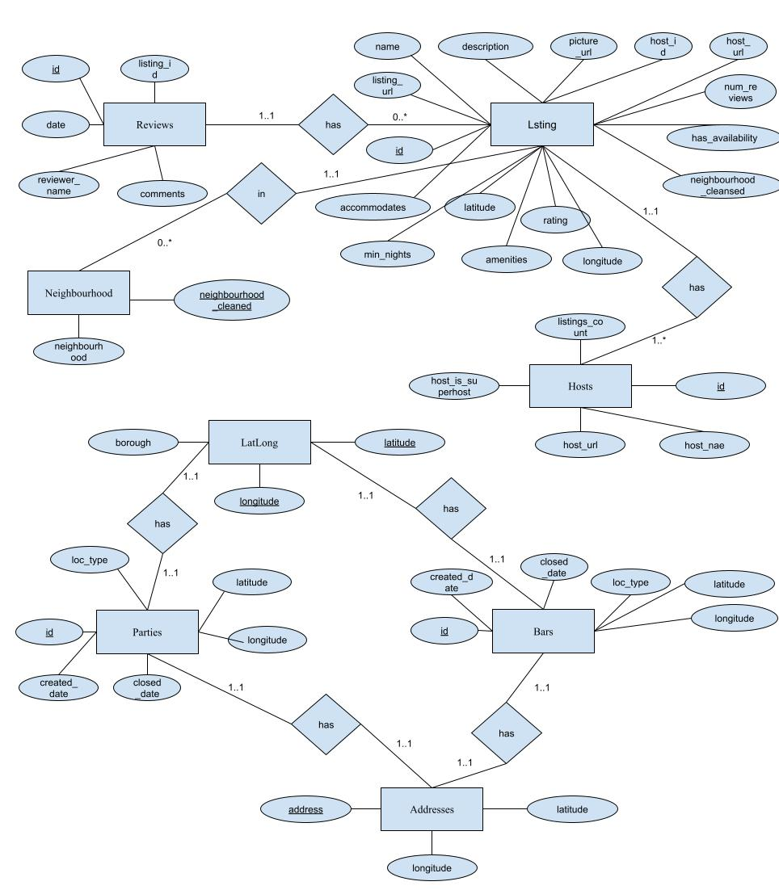
ER Diagram
LatLong (latitude, longitude, borough);
Bars(id, location_type, latitude, longitude, num_calls)
FOREIGN KEY(latitude, longitude) REFERENCES LatLong(latitude, longitude)
FOREIGN KEY(latitude, longitude) REFERENCES Addresses(latitude, longitude)
Parties(id, created_date, closed_data, location_type, latitude, longitude)
FOREIGN KEY(latitude, longitude) REFERENCES LatLong(latitude, longitude)
FOREIGN KEY(latitude, longitude) REFERENCES Addresses(latitude, longitude)
Lsting(id, listing_url, name, picture_url, latitude, longitude, description, host_id, accommodates, amenities, price, minimum_nights, has_availability, number_of_reviews, rating, neighbourhood_cleansed, reviews_per_month);
FOREIGN KEY host_id REFERENCES Hosts(id)
FOREIGN neighbourhood_cleansed REFERENCES Neighbourhood(neighbourhood_cleansed)
Hosts(id, host_url, host_name, host_is_superhost, host_total_listings_count);
Reviews(id, listing_id, date, reviewer_name, comments);
FOREIGN KEY listing_id REFERENCES Lsting(id)
Addresses(latitude, longitude, address);
FOREIGN KEY(latitude, longitude) REFERENCES LatLong(latitude, longitude)
Neighbourhood(neighbourhood, neighbourhood_cleansed);
Notes:
Aakash J

Slide 7
Application Stack
HTML/CSS
React
Javascript
SQL - hosted on AWS
Additional Libraries used:
Bootstrap
Shard react
React-vis
React-select
React-icons
Notes:
Karan J

Slide 8
Demo
Notes:
Everyone

Slide 9
Example Simple Queries
SELECT DISTINCT AVG(rating) as avg, host_url, host_name
FROM Lsting
JOIN Neighbourhood on Lsting.neighbourhood_cleaned = Neighbourhood.neighbourhood_cleansed
JOIN Hosts on Lsting.host_id = Hosts.id
WHERE neighbourhood = '${borough}' AND host_total_listings_count >= 3
AND host_is_superhost = 1 AND number_of_reviews >= 10
GROUP BY host_id
ORDER BY avg DESC
LIMIT 5;
SELECT neighbourhood_cleansed AS locality, Count(*) AS num
FROM Lsting JOIN Neighbourhood on Lsting.neighbourhood_cleaned = Neighbourhood.neighbourhood_cleansed
WHERE neighbourhood = 'Bronx'
GROUP BY neighbourhood_cleansed
ORDER BY num DESC;
Notes:
Kush

Slide 10
Example Complex Query
WITH tab1 AS (
SELECT latitude, longitude, COUNT(*) as NumParties
FROM Parties JOIN LatLong ON Parties.latitude = LatLong.latitude AND Parties.longitude = LatLong.longitude
WHERE Borough LIKE '${x}'
GROUP BY latitude, longitude),
tab2 AS
(SELECT * FROM tab1
WHERE NumParties > '${a}' and NumParties <= '${b}'),
tab3 AS
(SELECT *
FROM Lsting JOIN Neighbourhood on Lsting.neighbourhood_cleaned = Neighbourhood.neighbourhood_cleansed
WHERE neighbourhood LIKE '${x}' ORDER BY number_of_reviews * rating),
tab4 AS
(SELECT id, name, listing_url, price, rating, number_of_reviews, picture_url
FROM tab3 JOIN tab2 ON ABS(tab3.latitude - tab2.latitude) <= .001 AND ABS(tab3.longitude - tab2.longitude) <= .001
LIMIT 20),
tab5 AS
(SELECT * FROM Bars JOIN LatLong ON Bars.latitude = LatLong.latitude AND Bars.longitude = LatLong.longitude
WHERE Borough LIKE '${x}' and num_calls > '${c}' and num_calls <= '${d}'),
tab6 AS
(SELECT tab3.id, name, listing_url, price, rating, number_of_reviews, picture_url
FROM tab3 JOIN tab5 ON ABS(tab3.latitude - tab5.latitude) <= .001 AND ABS(tab3.longitude - tab5.longitude) <= .001
LIMIT 20),
tab7 AS
(SELECT * FROM tab4
UNION
SELECT * FROM tab6)
SELECT DISTINCT id, name, listing_url, price, rating, number_of_reviews, picture_url FROM tab7
ORDER BY number_of_reviews * rating DESC
LIMIT 10;
Notes:
Yathu

Slide 11
Example Complex Query 2
WITH tab1 AS (SELECT id, name, comments, amenities,
room_type, price, listing_url, picture_url, host_name, host_url
FROM Lsting JOIN reviews ON Lsting.id = reviews.listing_id
JOIN Hosts ON Hosts.id = Lsting.host_id
WHERE Lsting.price <= 500 AND Lsting.host_is_superhost = 0
AND Lsting.accommodates >= 1 AND description LIKE '%beautiful%'),
tab2 AS (SELECT id, name, comments, amenities, room_type, price,
listing_url, picture_url, host_url, host_name
FROM tab1
WHERE amenities LIKE '%Wifi%'),
tab3 AS (SELECT id, name, comments, amenities, room_type, price,
listing_url, picture_url, host_url, host_name
FROM tab2 WHERE amenities LIKE '%TV%'),
tab4 AS (SELECT id, name, comments, amenities, room_type, price,
listing_url, picture_url, host_url, host_name
FROM tab3
WHERE amenities LIKE '%""%')
SELECT DISTINCT id, name, room_type, price,
listing_url, picture_url, host_url, host_name
FROM tab3
WHERE amenities LIKE '%%' AND (comments LIKE '% %'
OR comments LIKE '% %' OR comments LIKE '% Wifi %' OR comments LIKE '% TV %')
LIMIT 10;
Notes:
Kush

Slide 12
Performance
Query Description | Pre-optimisation | Post optimisation
Find Airbnbs based on party and bar intensity | 2.417s | 0.544s
Find listings and their descriptions closest to the locations with lowest amount of party and bar activity in Manhattan | 7.625s | 0.048s
Find listings and their descriptions closest to the locations with highest amount of party and bar activity in Manhattan | 12.715s | 1.407s
Find Airbnbs that fulfill various criteria (price, super host etc) and check if amenities are mentioned in comments | 29.594s | 1.609s
Top hosts in a particular borough | 0.123s | 0.059s
Notes:
Yathu + Kush

Slide 13
Technical Challenges
Not being familiar with Github and facing a lot of merge conflicts initially
Communication as well as working with distinct branches
Performance issue with AWS
Query optimization
Clearing dead access that was never killed which caused significant latency
Notes:
Karan J

Slide 14
Further Work
Expanding the use to cities beyond New York City
Easy to find similar data on other metropolitan cities
Will help us attract more people to the website
Implementing a login system
Makes website more personal
Recommendations based on previous searches
Linking to social media will allow people to share their Airbnb experience with friends and family
UI can be modeled after Airbnb to reduce the learning curve
Interactive components such as maps, host updates etc.
Notes:
Karan J

Slide 15
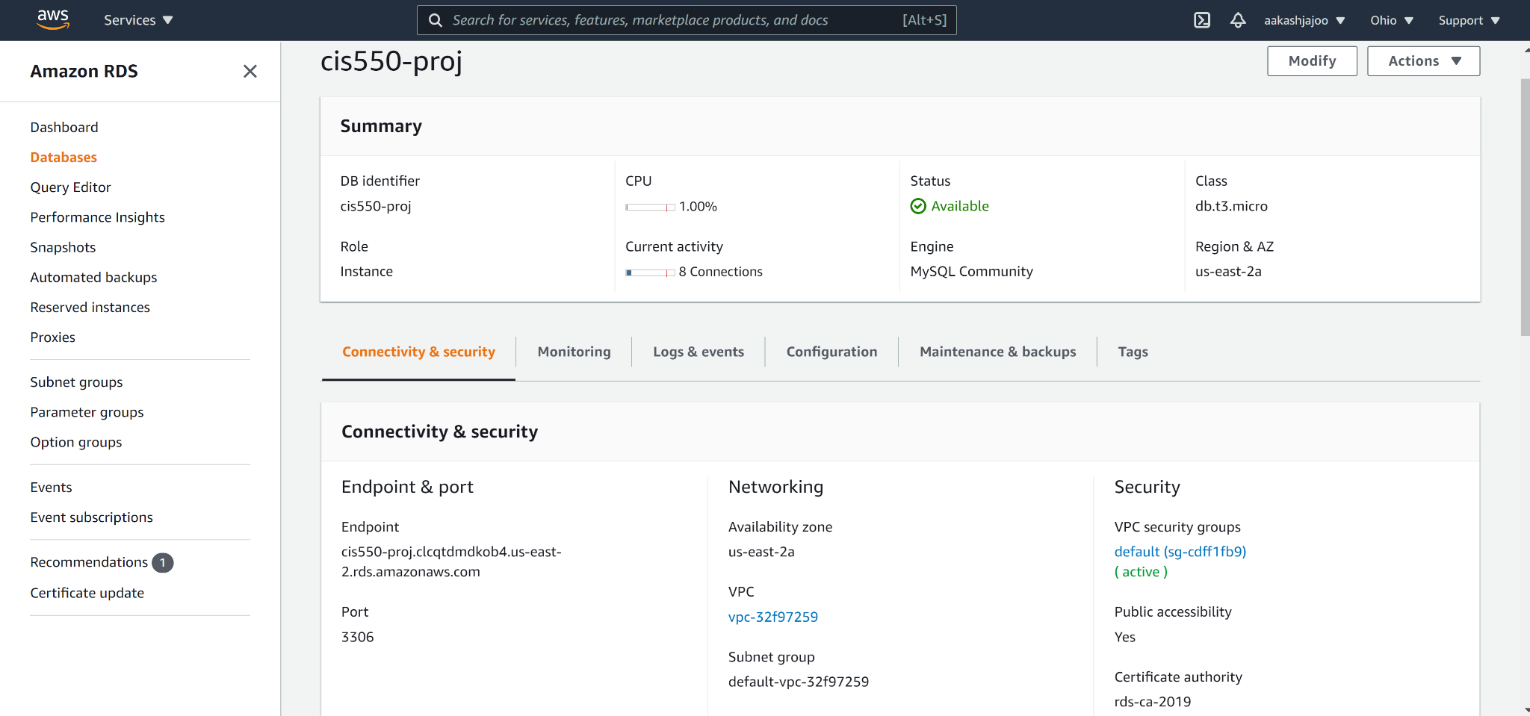
Extra Credit
Hosting Backend on AWS
Notes:
Aakash J

Slide 16
Thank you!
Questions?

